Slide 1
Proposal to Update New Mexico Water Quality Standards: Copper Site-Specific Water Quality Criteria for the Pajarito Plateau
Barry Fulton
Windward Environmental, LLC
November 30, 2021

Slide 2
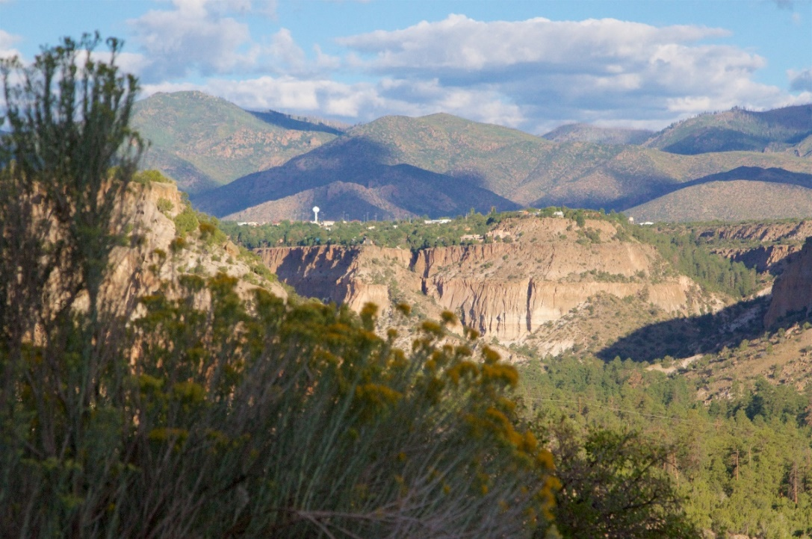
Objective
Develop a proposal for the New Mexico Water Quality Control Commission to adopt EPA’s 2007 recommended copper ambient water quality criteria.

Slide 3
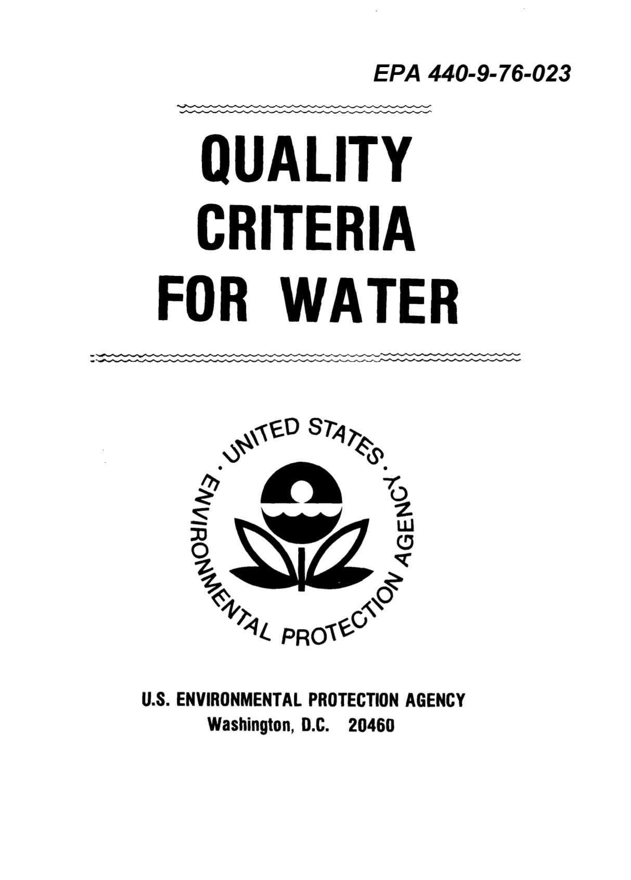
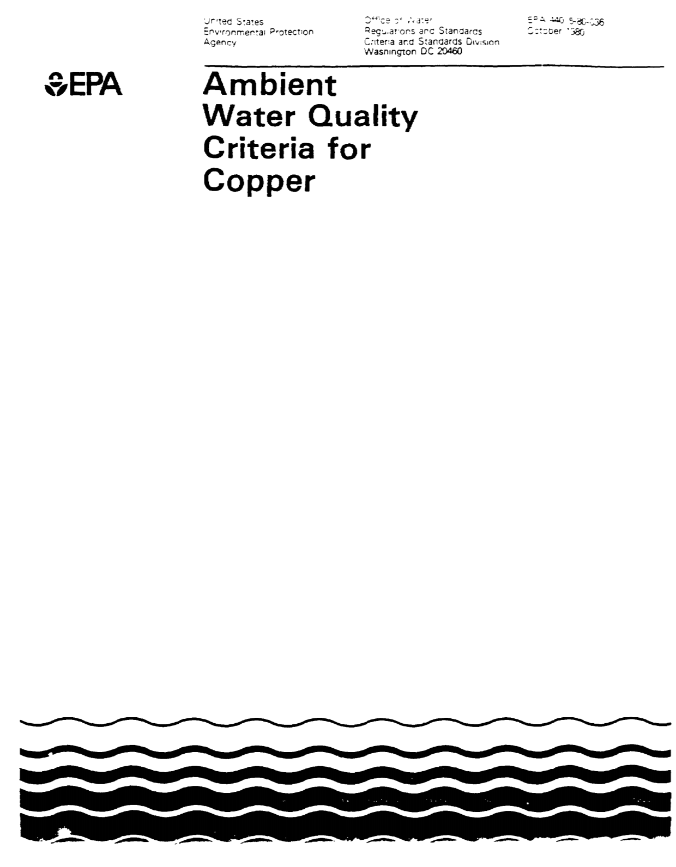
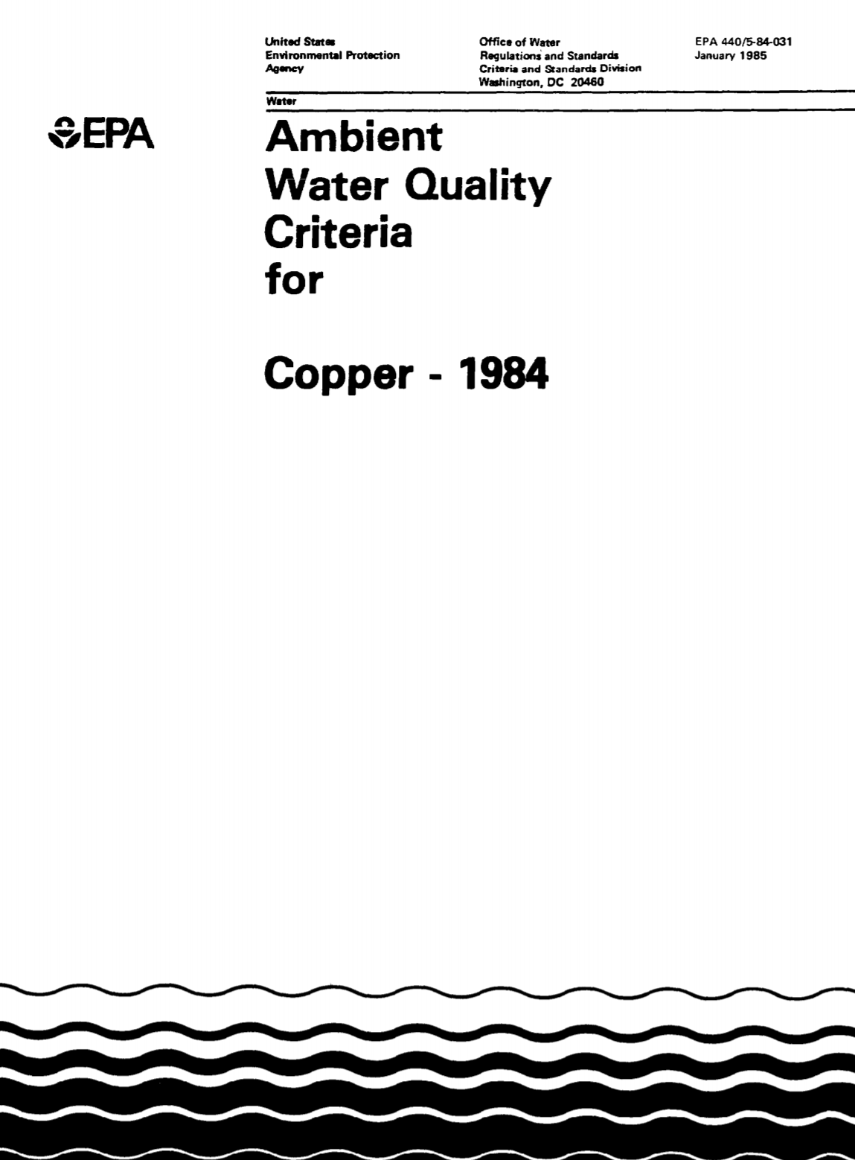
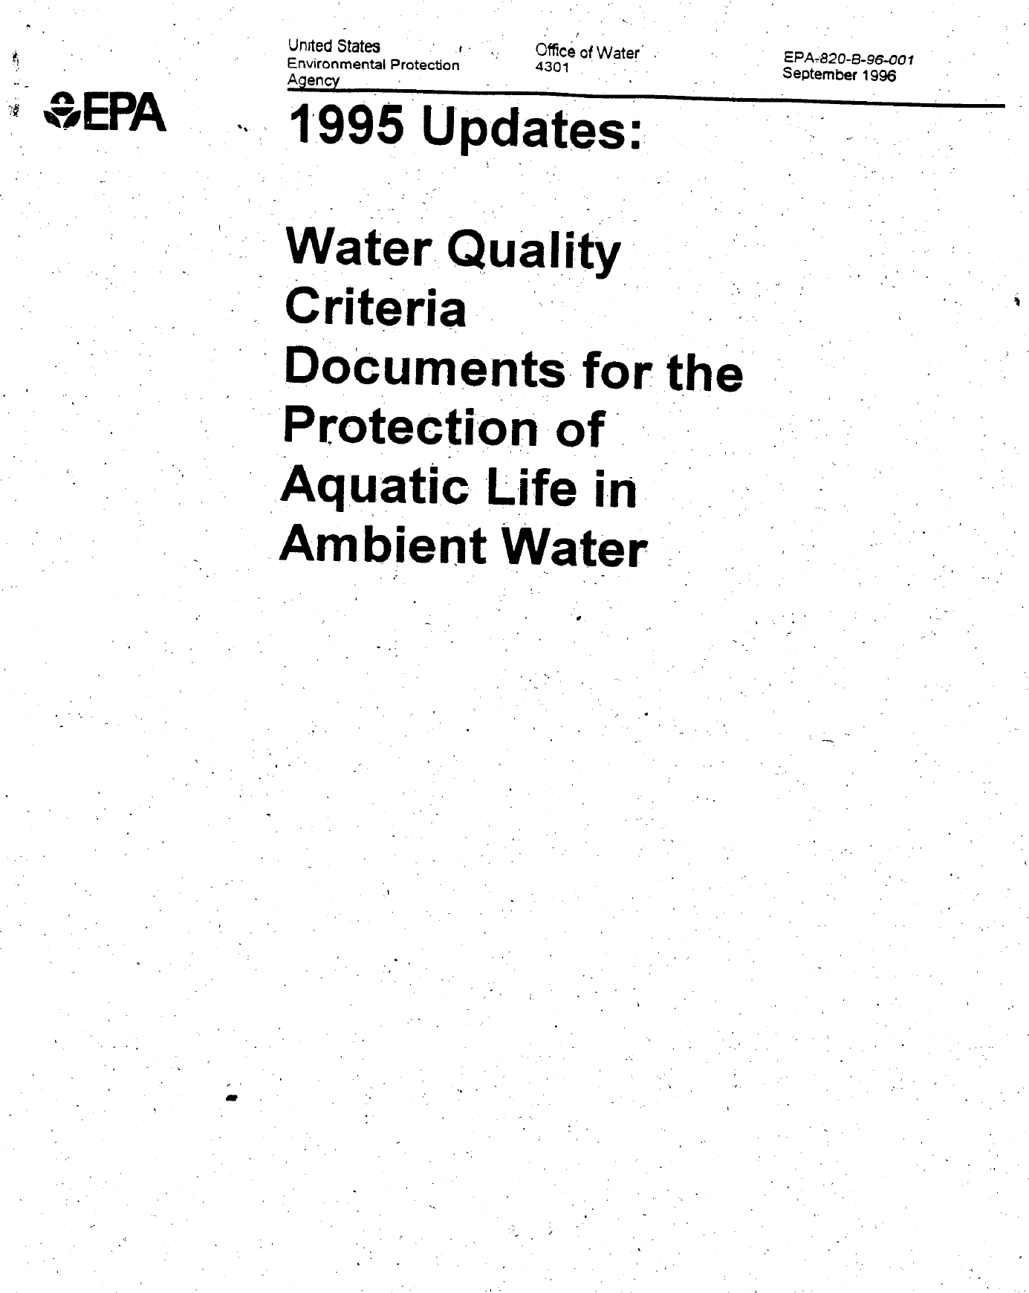
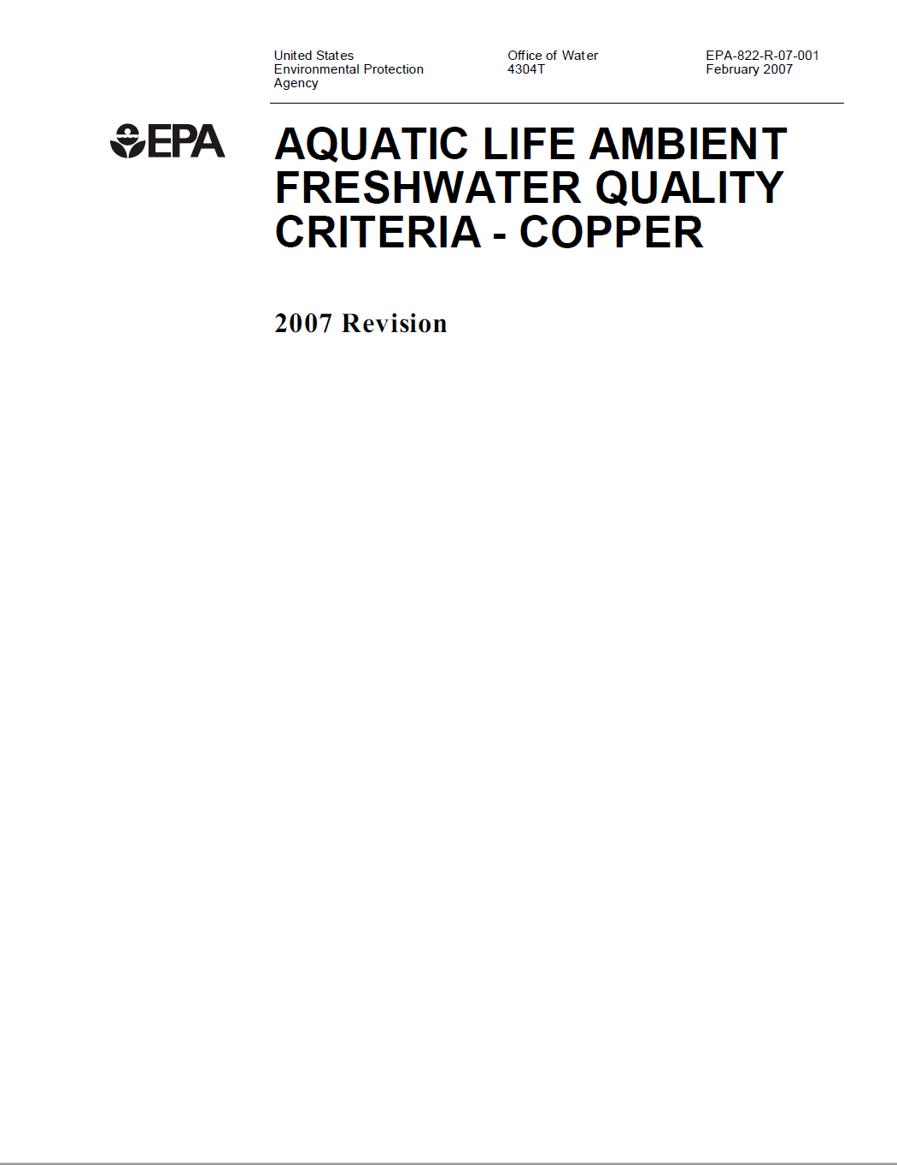
Background
History of U.S. EPA National Recommended Aquatic Life Criteria for Copper
1976 “Red Book”
1980
1984
1995
2007 “Cu BLM”
Current NM Cu
AWQC
Current EPA recommended Cu AWQC
Hardness-Based Criteria
Basis of SSWQC proposal
Updates based on best available science

Slide 4
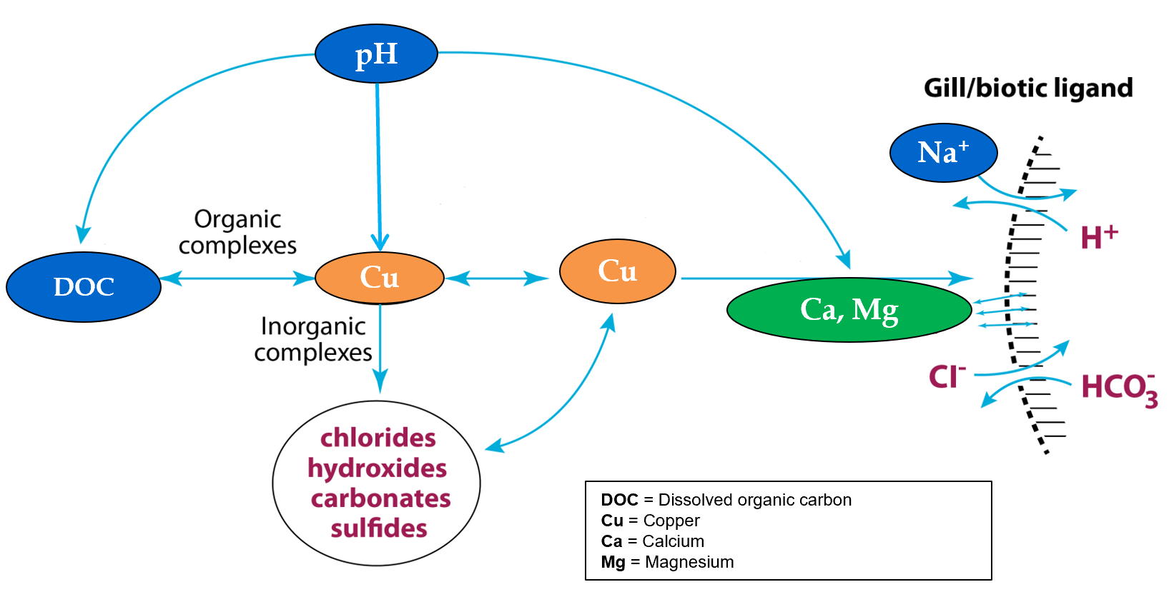
BLM Basics
A software tool used in aquatic toxicology that examines the bioavailability of metals in the aquatic environment and the affinity of these metals to accumulate in aquatic organisms
Best available science
Basis for national recommended criteria
Green indicates only parameters used in hardness-based AWQC
Blue indicates additional parameters used in BLM-based AWQC

Slide 5
Overview of Proposed Cu Site-Specific Water Quality Criteria (SSWQC)
Current NM Cu Water Quality Criteria (WQC):
Based on EPA (1996) hardness equation
Current EPA (§304a) Cu WQC:
Based on EPA (2007) biotic ligand model (BLM)
Approach for Cu SSWQC for the Pajarito Plateau:
Build an equation (like the hardness equation) with other water chemistry parameters as needed to accurately generate BLM-based criteria
Called a Multiple Linear Regression (MLR) equation

Slide 6
Proposed Cu SSWQC Compared to Current NM Cu WQC
Cu WQC Equation
EPA Reference
Current NM Cu WQC
Cu WQC = Exp [Intercept + f(hardness)
EPA (1996)
Proposed SSWQC for Pajarito Plateau
Cu WQC = Exp [Intercept + f(pH) + f(DOC) + f(hardness)
EPA (2007)

Slide 7
Proposed Cu SSWQC
SSWQC_{acute} = exp(-22.912 + 1.017*ln(DOC) + 0.045*ln(hardness) + 5.176*pH – 0.261*pH²)
SSWQC_{chronic} = exp(-23.382 + 1.017*ln(DOC) + 0.045*ln(hardness) + 5.174*pH – 0.261*pH²)
Works well across ephemeral, intermittent, perennial streams
Applicable to any waterbody on the Pajarito Plateau

Slide 8
Responsible Use of Public Dollars
175 exceedances of current hardness-based criteria
5 exceedances of proposed hardness, pH & DOC-based criteria
Every point in the shaded lower right-hand quadrant represents a false positive exceedance
170 false positives
5 true positives
285 true negatives
Note: excludes samples with Cu detection limits > BLM or hardness-based criteria
Exceedance Ratio = Cu concentration / criterion

Slide 9
What’s Next?
Demonstration Report
Agency Review
Stakeholder & Public Review
Petition & Rulemaking
Demonstration Report
Presents and justifies derivation of copper SSWQC pursuant to 20.6.4.10 NMAC requirements
Agency Review
NMED & EPA review and comments on Demonstration Report
Stakeholder & Public Review
Targeting Winter 2021/22 for public review of Demonstration Report
Written comments will be solicited
Public meetings will be held
Petition & Rulemaking
A petition for copper SSWQC will be developed based on (1) conclusions presented in the final Demonstration Report, (2) NMED and EPA comments, and (3) comments from other potential stakeholders, tribes, and the general public

Slide 10
Questions?
Produced by Los Alamos Legacy Cleanup Contractor, N3B Los Alamos on behalf of DOE’s Environmental Management Los Alamos Field Office

